Slide 1

Senior Capstone Research Project Overview
NFL Draft Data Analysis
Kyle McCullough
Wisconsin-River Falls 2023

Slide 2

NFL Draft Data Analyzation
Pro Football Reference Data
Analyzing with wAV
NFL Draft Pick Value Model
NFL Draft Pick Positional Value Models
NFL career predictor

Slide 3

Pro Football Reference Data
Data Source for Research Paper
Pro Football Stats, History, Scores, Standings, Playoffs, Schedule & Records | Pro-Football-Reference.com
Weighted Approximate Value (wAV)
Calculation
Examples

Slide 4
Analyzing with wAV
Franchise Draft Success Analyzation
College Draft Prospects Analyzation
Draft Class Analyzation

Slide 5
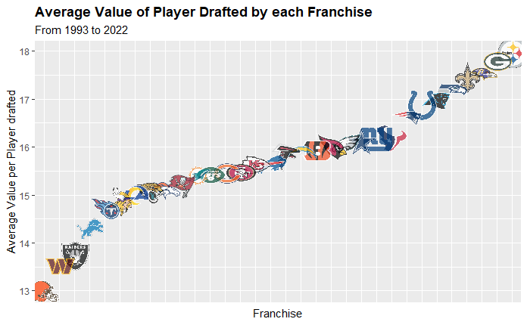
Franchise Draft Success Analyzation
Steelers, Packers, Ravens among top of list
Browns, Commanders, Raiders on bottom

Slide 6
College Draft Prospects Analyzation
College | sumwAV
Miami (FL) | 3435
Ohio St. | 3386
Florida St. | 3211
Alabama | 3085
LSU | 3081
Georgia | 3020
USC | 2798
Michigan | 2673
Florida | 2668
Notre Dame | 2352
Tennessee | 2339
California | 2191
Texas | 2078
Penn St. | 2071
College | averagewAV
Boston Col. | 30.263158
Miami (FL) | 27.69
Michigan | 26.924051
Mississippi | 26.756757
Texas | 26.322581
Purdue | 26.073171
California | 25.261538
Auburn | 25.245614
Memphis | 24.285714
Oklahoma St. | 24.041667
Georgia | 22.988636
Virginia | 22.842105
LSU | 22.5
Utah | 22.410256
Arizona St. | 13.868852
Clemson | 13.320755
Wake Forest | 13.26087
Arkansas | 13.119048
Wisconsin | 12.969697
Kansas | 12.92
Cincinnati | 12.90625
Kentucky | 12.65625
Colorado St. | 12.347826
Stanford | 12.339623
Southern Miss | 11.791667
Baylor | 11.238095
Northwestern | 11.142857
Minnesota | 11.041667
BYU | 8.972222

Slide 7
Draft Class Analyzation
Draft | sumwAV
2006 | 5035
1993 | 4987
1996 | 4899
2001 | 4776
2003 | 4731
2012 | 4652
1998 | 4585
2005 | 4573
2010 | 4552
2000 | 4499
2004 | 4466
2011 | 4461
1997 | 4330
2002 | 4317
1999 | 4289
2008 | 4227
2007 | 4175
2014 | 4166
1995 | 4101
1994 | 4076
2016 | 3997
2009 | 3978
2013 | 3977
2015 | 3791
2017 | 3640
2018 | 3420
2019 | 2496
2020 | 1999
2021 | 1298
2022 | 611

Slide 8
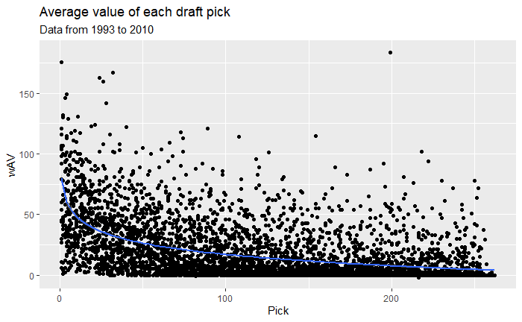
NFL Draft Pick Value Model
Plotted Data
Adjusted Data
Created Models
Compared Models
Graphed Model
Created Application

Slide 9
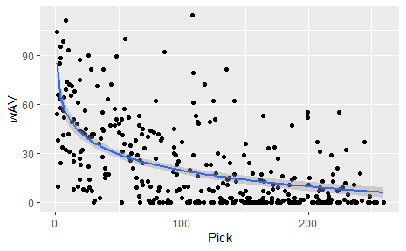
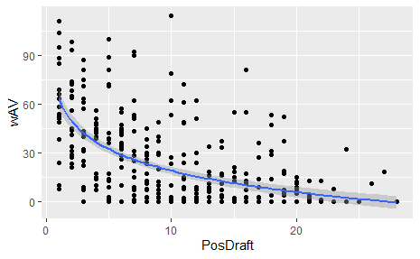
NFL Draft Pick Positional Value Models
When should positions be drafted?
Looked at Positional Value per Pick and Positional Value per Positional Pick

Slide 10

NFL Career Predictor
Attempted to create career predictor using past data from Pro Football Reference including combine and college stats but ran out of time.

Slide 11

Publisher
Journal of Sports Analytics
Popular Sports Analytics Journal used throughout multiple professional sports organizations

Slide 12
Conclusion

